Slide 1
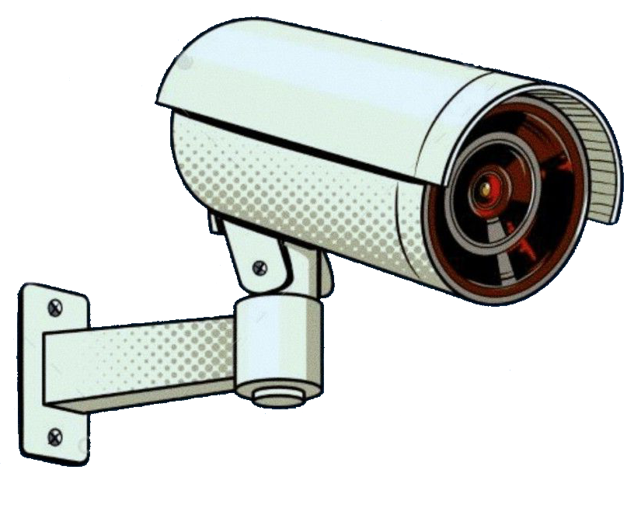
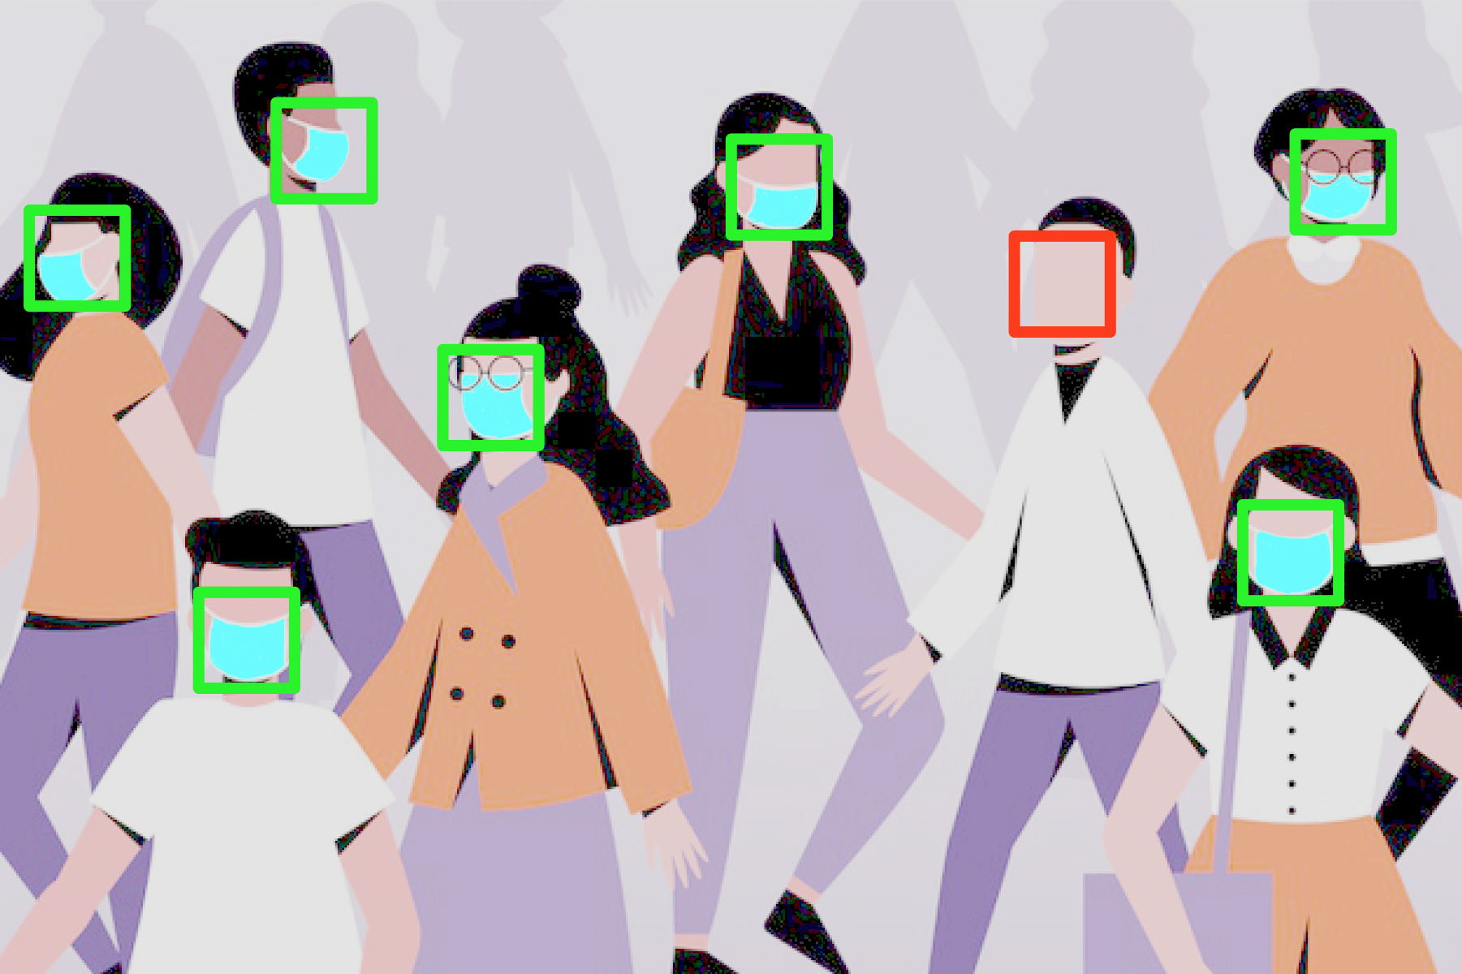
Face Mask Detector
Ori Kleinhauz
Michael Goncharov
Andrey Bakhmat
Jonathan Bitton
ITC Data Science Fellows June 2020 Cohort

Slide 2
World Health Organisation
Coronavirus disease (COVID-19) advice for the public
“Masks are a key tool in a comprehensive approach to the fight against COVID-19 virus”

Slide 3
Detecting Unmasked Faces In Real Time VIdeo
Problem Statement:

Slide 4
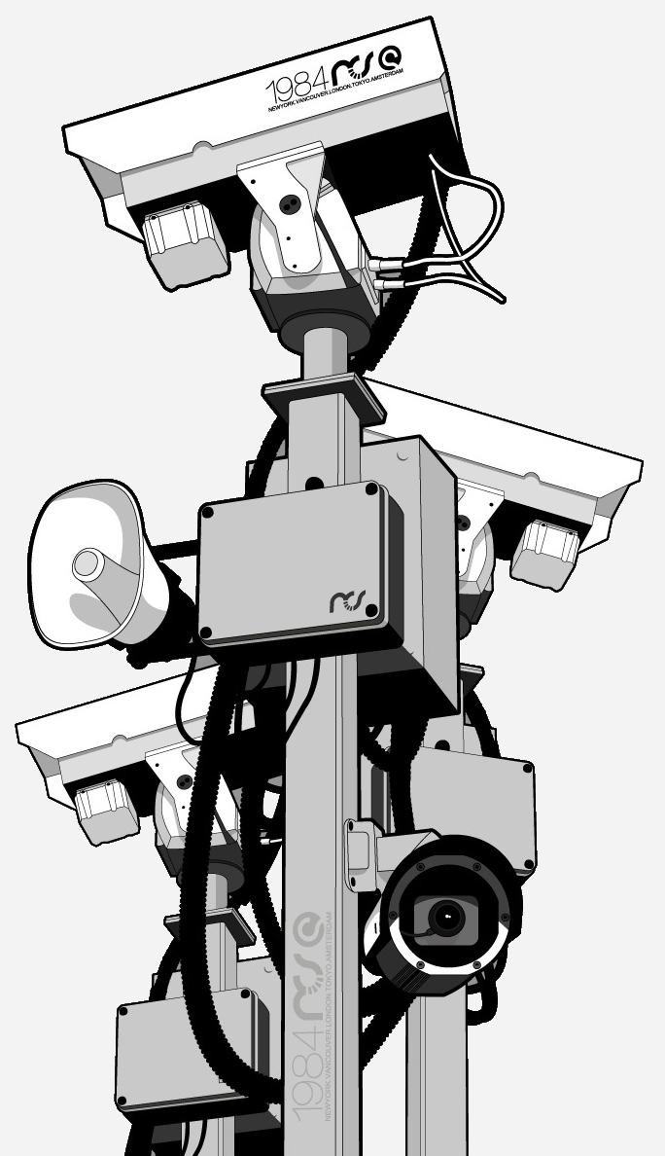
Business Opportunity
a video surveillance system in public places where wearing of face masks is required
corporate video surveillance systems reminding employees to wear masks correctly
any other use cases where it is important to ensure visual control over the use of protective equipment
in
Notes:
The mask detection project is of high social importance and can be integrated into various systems:
a video surveillance system in public places where wearing of face masks is required
corporate video surveillance systems reminding employees to wear masks correctly
any other use cases where it is important to ensure visual control over the use of protective equipment
The end users of the system can be health authorities, operators of video surveillance systems in public places, any corporate users who need to monitor compliance with sanitary standards.
The current version of the project is ready as a mock-up for demonstration for system integrators who are implementing such technologies into video surveillance systems and able to provide feedback from the end users.

Slide 5
Technical Goals
Accurately determine whether or not a person in a picture is wearing a mask
detect faces frontally in real time video and determine whether they’re wearing masks on a frame-by-frame basis

Slide 6
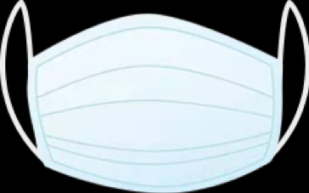
Original Dataset - Description
Creation Method
Size
Mostly artificially generated, looping over photos of people without masks and adding image of a typical mask
with_mask: 690 images
without_mask: 686 images
total 1,376 images
Source
available at github
Author
Prajna Bhandary

Slide 7
Original Dataset - Features
Males and females are represented equally
People of all colors and ages
Multiple versions of same individual with rotation/inversion/blur/noise
In some pictures the mask isn’t worn properly
One picture may contain multiple masks, and not all are frontal
Lighting conditions change
Backgrounds are not uniform
Camera angles differ

Slide 8
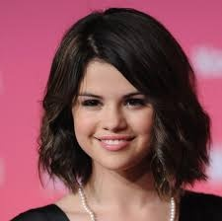
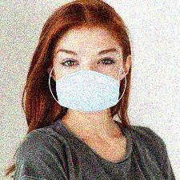
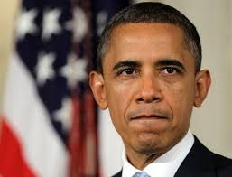
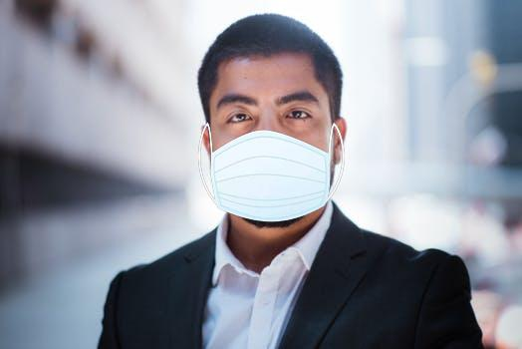

Slide 9
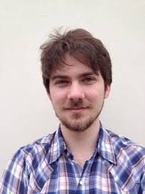

Baseline Approach - Data Preprocessing
DATASET PREPROCESSING
Grayscale : It’s enough to identify the person’s face, as color image (which will increase the number of inputs and so the risk of overfitting) won’t have a real added value.
Resizing : To a format 50x50
Normalize the pixel arrays
Convert class vectors to binary class matrices for use with keras

Slide 10
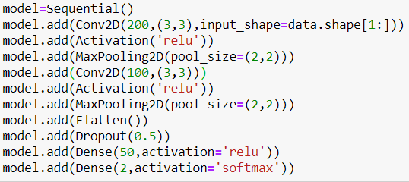
Baseline Approach - Data Modeling
Using transfer learning:
Network architecture: CNN
Optimizer: Adam
Loss: Binary Cross Entropy

Slide 11
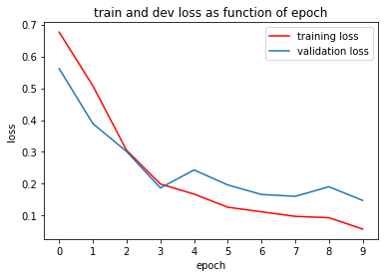
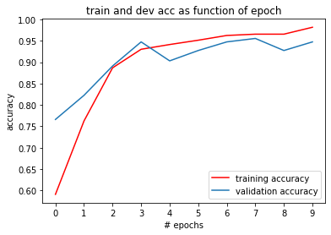
Baseline Approach - Training
10 Epoches - a good trade-off between accuracy and computation time

Slide 12
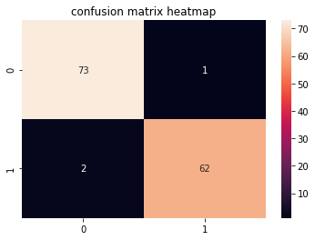
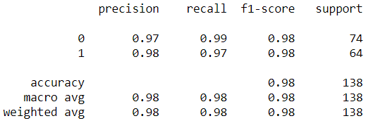
Baseline Approach - Evaluation
97.8% accuracy on test set

Slide 13
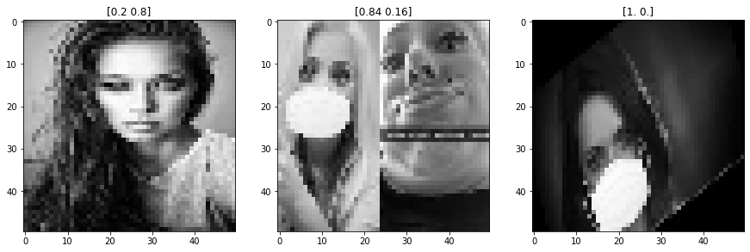
Baseline Approach - Misclassified

Slide 14
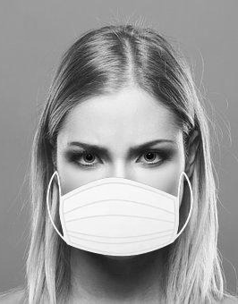
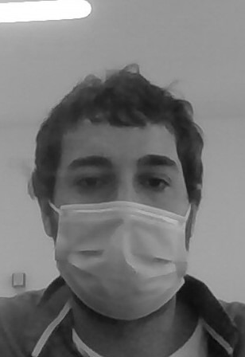
Baseline Approach - A dead end
Despite the excellent accuracy, model always predicts no mask for masked selfies. Wut?
Model always labels face in video as ‘without mask’
MIght it have to do with the overlaid mask’s brightness? Or perhaps its uniform shape?
‘with mask’ output for image in dataset
‘without mask’ output for an uploaded selfie

Slide 15
Alternative Dataset - Description
Creation Method
Size
Real Photos of people wearing with various types of masks, compiled from multiple sources
with_mask: 1,915 images
without_mask: 1,918 images
total 3,833 images
Source
Bing search API
Kaggle datasets
RMFD dataset
available at Drive
Author
Multiple authors

Slide 16
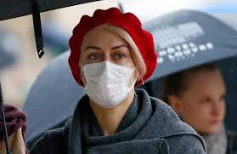
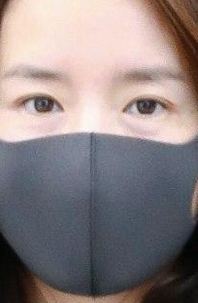
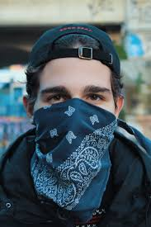
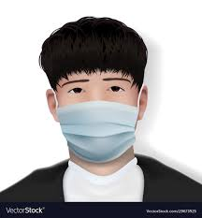

Slide 17
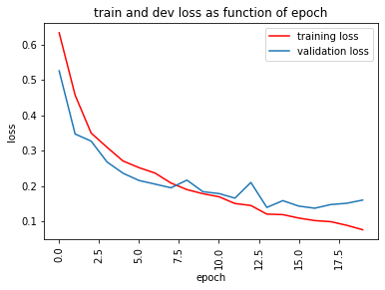
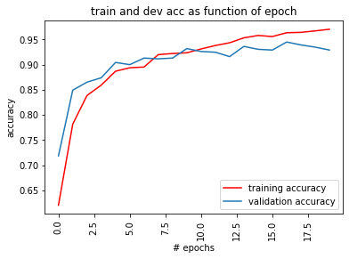
Alternative Dataset - Training
Checkpoints and early stopping to find best model at reasonable cost

Slide 18
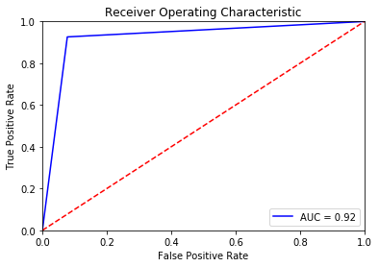
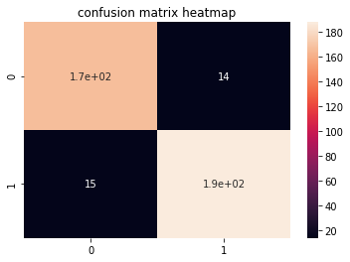
Alternative Dataset - Evaluation
95.3% accuracy on test set

Slide 19

Demo - Single Face

Slide 20
Demo - Multiple Faces

Slide 21
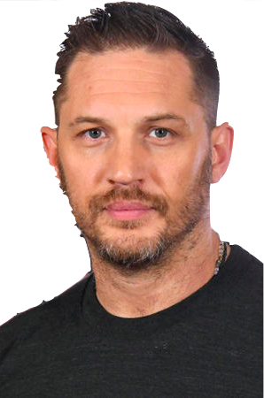
Challenges
Dataset Issues
Artificially generated mask image placed on various frontal face photos.
This causes the model to overfit, whether because of the mask’s brightness or its unvarying design.
Models trained on this dataset always predicted ‘without mask’ on the selfies we tested, and as a result, caused the video to always display ‘without mask’.
Notes:
Initial dataset:
the masked photos consisted of an artificially generated mask image placed on various frontal face photos.
This causes the model to overfit, whether because of the mask’s brightness or its unvarying design.
Models trained on this dataset always predicted ‘no mask’ on the selfies we tested, and as a result, caused the video to always display ‘no mask’.
We had to find an alternative dataset to train the model on.

Slide 22
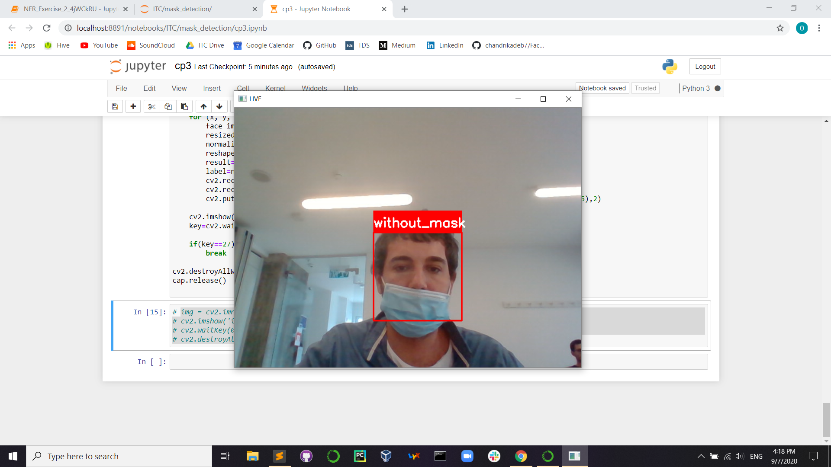
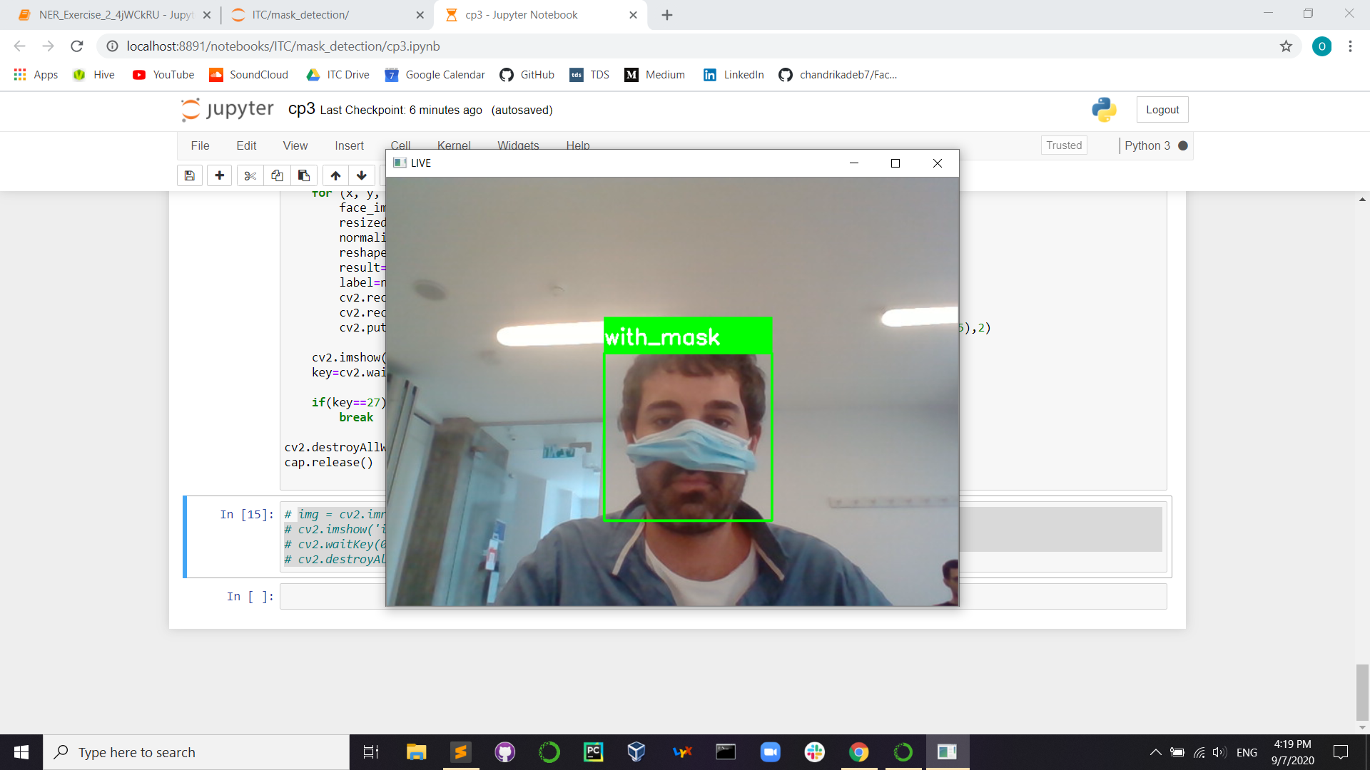
Challenges
Covered Nose
To test the threshold of the model’s no mask prediction, we lowered the mask gradually
Once the person’s nose becomes exposed, the model predict ‘without mask’
We began to suspect that the model places too much importance on nose coverage
When only the nose is covered, the model predicts ‘with mask’
Notes:
To test the threshold of the model’s no mask prediction, we lowered the mask gradually
Once the person’s nose becomes exposed, the model predict ‘without mask’
We began to suspect that the model places too much importance on nose coverage
When only the nose is covered, the model predicts ‘with mask’

Slide 23



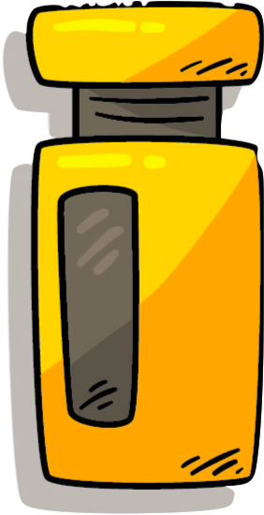
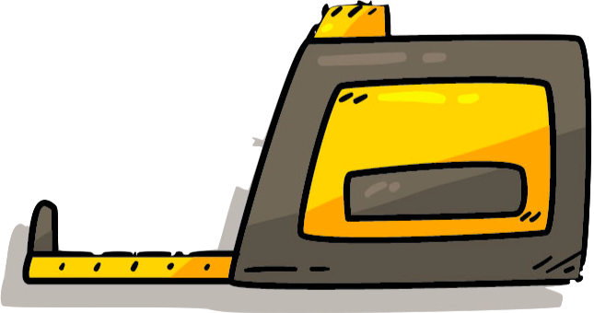

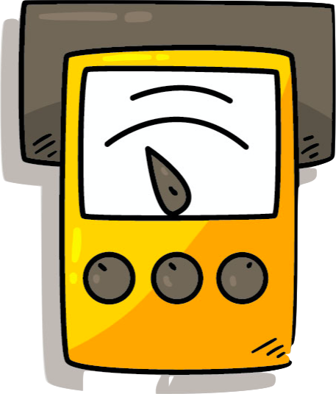
Challenges
Video Metric
Possible solution: Frame-by-frame labeling for a pre-recorded video
Notes:
In order to create a well-defined metric for a pre-recorded video, we would have needed to label it frame-by-frame and compare the labels to the prediction. Apart from this being a tedious and extremely time-consuming task, it also defeats the purpose of the project, namely, real-time video classification. Hence we had to settle for perceived accuracy as the metric for this part, which would be useless in the real life case of humanless monitoring

Slide 24
Conclusion
Detect faces non-frontally
Run a moving average on consecutive frames with an appropriate time window to avoid false alarms
Enrich dataset with partially worn masks, to create a third class ‘worn improperly’
Next Steps
Hindsight
We might and should have payed more attention to planning and assigning tasks to team members to distribute the workload more evenly

Slide 25

Thanks
Ori Kleinhauz
Michael Goncharov
Andrey Bakhmat
Jonathan Bitton
ITC Data Science Fellows June 2020 Cohort

